Slide 1

SWE 312: Theory of Computation
SWE 312: Lecture 03
Fatama Binta Rafiq (FBR)
Lecturer, Department of Software Engineering

Slide 2
Finite Automata:
Two categories of Finite Automata:
Deterministic Finite Automata (DFA)
  The machine can exist in only one state at any given time
Non-deterministic Finite Automata (NFA)
  The machine can exist in multiple states at the same time

Slide 3
Deterministic Finite Automata (DFA):
A Deterministic Finite Automaton (DFA) is a finite state machine that accepts/rejects finite strings (sequence of symbols or alphabets) and perform unique computation for each input string.
Deterministic refers to the uniqueness of the computation.

Slide 4
Deterministic Finite Automata (DFA):
A DFA is defined by the 5-tuples:
  {Q, ∑ , q₀,F, δ }
It consists of:
    Q ==> a finite set of states
    ∑ ==> a finite set of input symbols (alphabets)
    q₀ ==> a start state (q₀ ∈ Q)
    F ==> set of final states (subset of Q)
    δ ==> a transition function, from Q x ∑ ==> Q

Slide 5
DFA Computation [1/3]:
Let us consider an example, where a string is given and have to calculate that the string is present in the language or not ?
Given, L is a Finite language;
∑ = { a, b }
L1 = Set of all strings starts with “a”
={ a, aa, ab, aaa,…. }
String, S = aab
The DFA for this calculation is given in next slide:

Slide 6
DFA Computation [2/3]:
a,b
A
a
B
b
C
a,b

Slide 7
DFA Computation [3/3]:
Steps:
Start from the “start state/ initial state”
For every input symbol in the string we do the following:
Compute the next state from the current state, given the current input symbol from the string and the transition function
After all symbols in that strings are calculated, if the current state is one of the final states (F) then we can say the string will be accepted by that DFA;
Otherwise, the string will be rejected.

Slide 8
DFA Computation:
Let us consider another example, where a string is given and have to calculate that the string is present in the language or not ?
Given, L is a infinite language;
∑ = { a, b }
L1 = Set of all strings starts with “a”
={ a, aa, ab, aaa,…. }
String, S = bba
Here, S = bba is not present in the language and it is invalid operation for computation.

Slide 9
Construct a DFA:
Build a DFA for the following language:
  L = {w | w is a binary string that contains 01 as a substring}
Steps for building a DFA:
  ∑ = {0,1}
  Decide on the states: Q
  Designate start state and final state(s)
  δ: Decide on the transitions
Final states == accepting states
Other states == non-accepting states

Slide 10
DFA for strings containing {01}
State Diagram
Q = {q₀,q₁,q₂}
∑ = {0,1}
start state = q₀
F = {q₂}
Transition Table
1
0
0,1
start
0
1
q₀
q₁
q₂
Final
state
symbols
0
1
q₀
q₁
q₀
states
q₁
q₁
q₂
*q₂
q₂
q₂
Notes:
Cpt S 317: Spring 2009
School of EECS, WSU

Slide 11
Construct a DFA:
Build a DFA for the following language:
W ∈{a,b}; |W | ≥ 2
Solution:
∑ = {a,b}
L = {aa, ab, ba, bb, aaa…, bbb….}
State Diagram:
a, b
a , b
A
a, b
B
C

Slide 12
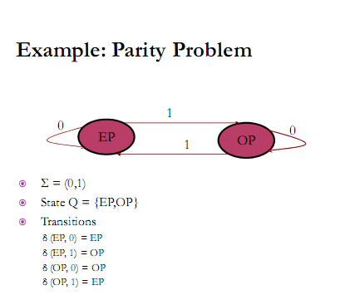
Example of DFA:

Slide 13
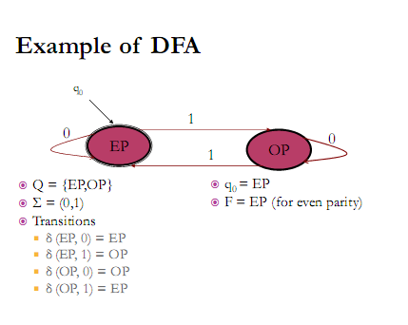
Example of DFA:

Slide 14

End of Slides

